Slide 1

Shipment price prediction
Add Subtitle

Slide 2
Abstract
This project centers on developing a machine learning system designed to protect the shipment cost for lost companies such as UPSC which is integral to their day to day operations to protect the model aims to enhance dynamic rising capability allowing these companies to assist shipping costs in real time based on UPS factors by integrating such a system logistic firms can optimize their delivery services minimizing losses due to unforeseen delays , And enhancing cost efficiency across the distribution network.
The goal behind this initiative is to assist logistics companies in overcoming challenges associated with traditional pricing models which often fails to account for complexities and variabilities of shipping. Tears include fluctuations in fuel prices differences and shipment rises in varying distances. The proposed system will leverage a data set comprising details of sculpture shipment which includes attributes such as artist name height with international shipping options etc fully stop these features are instrumental in reflecting the shipping costs.
By enabling more accurate and flexible pricing through heavy learning the model seeks to Deliver significant business improvement for the largest firms. This includes reducing operational losses and potential expanding the customer base by hovering more competitive prices the ultimate goal is to faster a more adaptable and economically efficient shipping industry

Slide 3
Motivation
The primary motivation of this project is to address the challenges faced by logistic companies such as UPSC in managing shipping costs efficiently. These companies routinely handle a wide variety of shipments including high value items such as sculptures under various conditions. The dynamic nature of shipping influenced by Many unpredictable factors such as weather traffic etc making static pricing models inaccurate. The models often fail to account real time costs associated with shipment leading to potential losses.
Further the largest industry is increasingly diverse by efficiency And the ability to reduce costs while maintaining high service quality. This project seeks to help companies with advanced tools to dynamically adjust the price based on data analysis, Enabling them to optimize their operations. By implementing a machine learning model that can accurately predict shipment cost based on current date, Companies can offer more competitors and reduce likelihood of costly delays.

Slide 4
Problem statement
The problem this project is addressing is the need for dynamic pricing in large industries particularly for the companies that handle deliveries and often sensitive shipments such as sculptures. Traditional pricing mechanism struggle to accurately reflect many factors that affect the shipment cost. Static pricing models are not equipped to handle wearability and unproductive which are often leading to loss of customers.
To resolve this issue the proposed machine learning system will analyze historical data and real time inputs to predict the most accurate pricing cost dynamically is capabilities crucial for last company aiming to improve the business operations avoiding financial losses.
Data Set Link –
https://www.kaggle.com/datasets/oossiiris/hackerearth-machine-learning-exhibit-art

Slide 5
Data Description
Artist Reputation: A numeric score representing the reputation of the artist. This could be examined to check if there's a correlation between an artist's reputation and shipping cost.
Dimensions (Height, Width): The size of the sculpture, which could significantly affect the shipping cost due to space occupation in transport vehicles.
Weight: The mass of the sculpture, likely a major factor in shipping cost, especially when considering different transportation methods.
Material: The type of material could influence the cost due to handling and care requirements (e.g., fragile materials may cost more to ship).
Shipping Details: Including base shipping price, international shipment, express shipment, and if installation is included. These categorical variables can impact the final cost.
Transportation Type (e.g., Airways, Roadways): This can affect speed and cost of delivery.
Fragility: Fragile items might incur higher costs due to special handling and packaging needs.
Customer Information: Details such as class and remote location can play a role in cost determination.

Slide 6
Potential Statistical Tests
Coalition analysis: To identify the relation between continuous variables and shipping cost.
Anova test: To identify is there any difference between cost for different material categories.
Regression analysis:
Linear recursion for predicting cost of shipment based on continuous predictors.
Michelin algorithms such as support vector machines are gradient boosting for complex modeling.

Slide 7
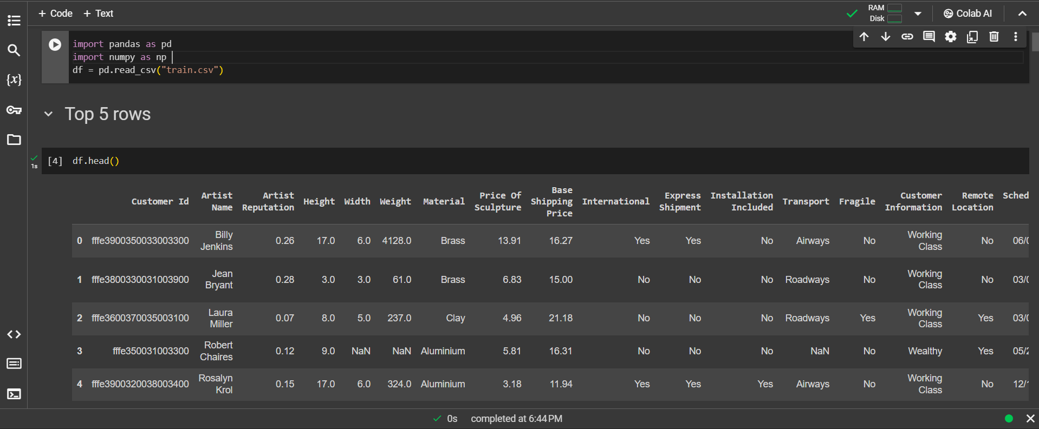
Loading the Dataset
In the 1st step we are loading the data from the CSV file to pandas datafarme.
Then we used the pandas dataframe head function to display the first 5 rows of the dataset

Slide 8
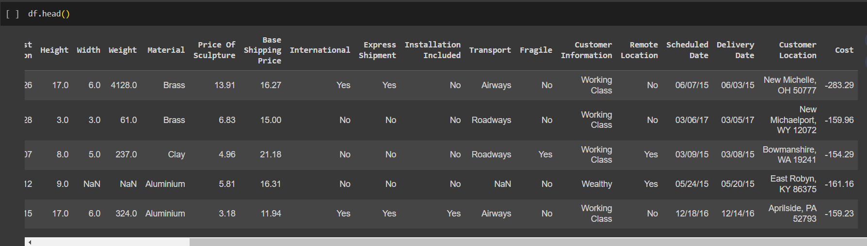
Dataset

Slide 9
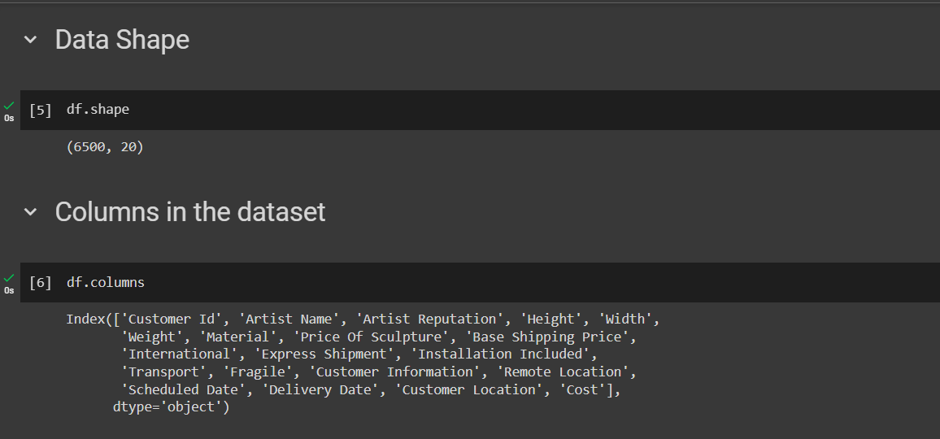
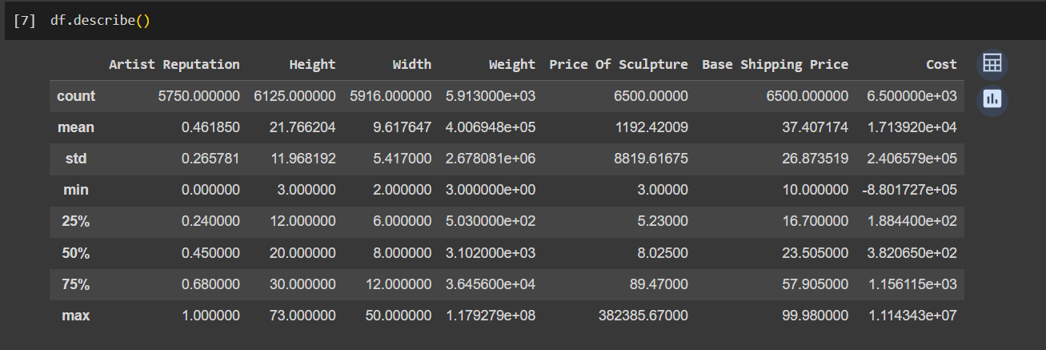
BASIC INFORMATION OF DATASET
Here we have checked the basic information like shape of the dataset , we have 6500 rows and 20 columns in the dataset.
Then we displayed all the columns in the dataset.
We also printed the basic Statistic information of the columns like mean , median , std ect

Slide 10
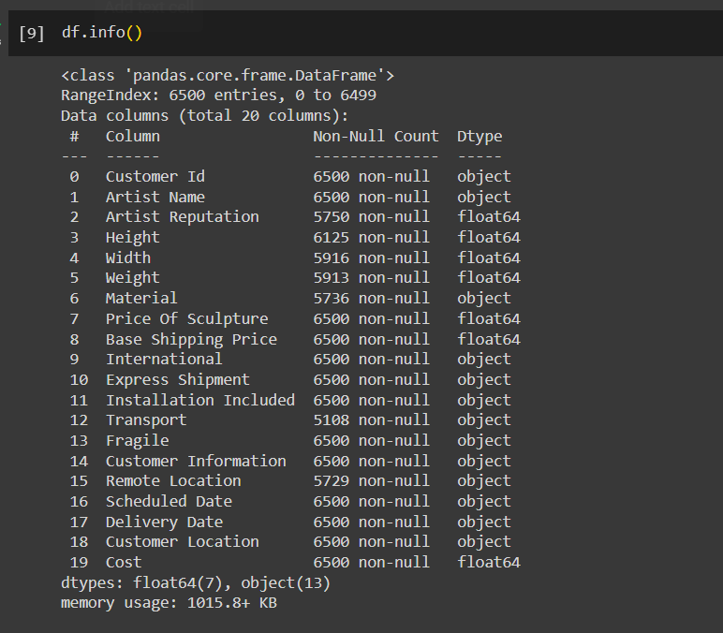
BASIC INFORMATION OF DATASET

Slide 11
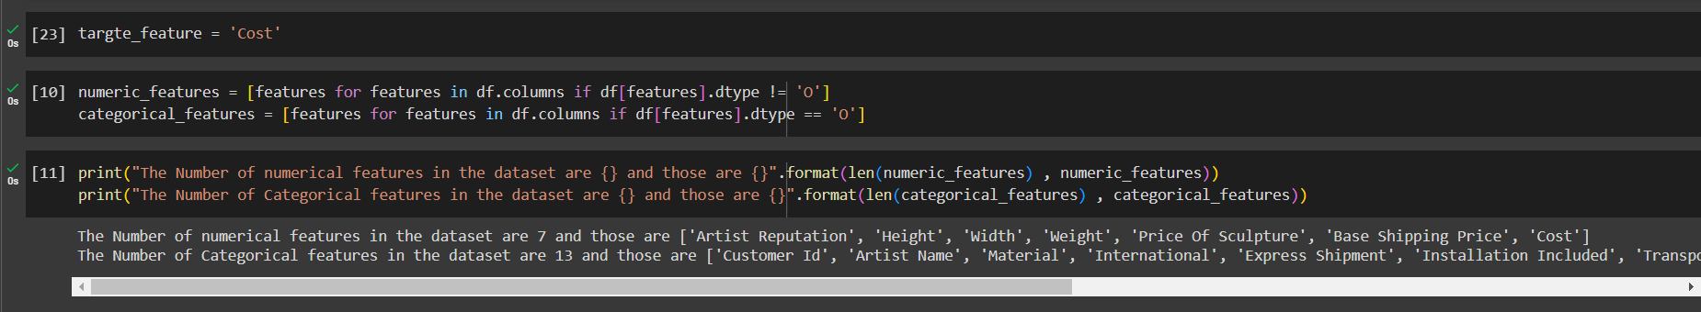
BASIC INFORMATION OF DATASET
The Number of numerical features in the dataset are 7 and those are ['Artist Reputation', 'Height', 'Width', 'Weight', 'Price Of Sculpture', 'Base Shipping Price', 'Cost’]
The Number of Categorical features in the dataset are 13 and those are ['Customer Id', 'Artist Name', 'Material', 'International', 'Express Shipment', 'Installation Included', 'Transport', 'Fragile', 'Customer Information', 'Remote Location', 'Scheduled Date', 'Delivery Date', 'Customer Location']

Slide 12
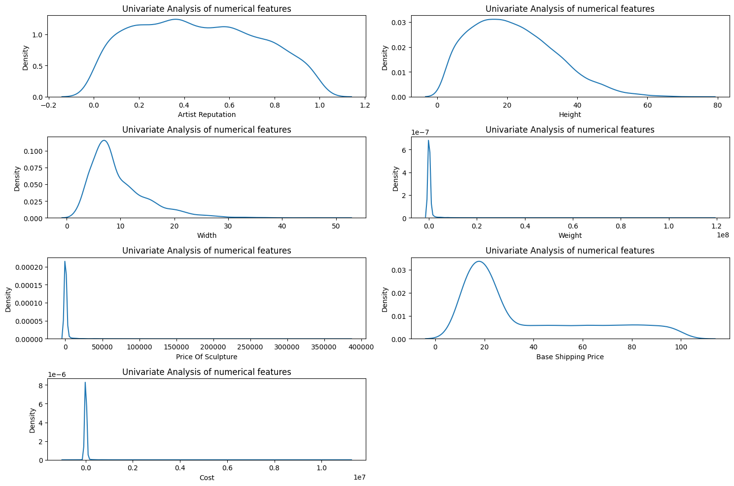
Distribution of numerical columns
Here we have the data Visualization library seaborn to display the distribution of all the numerical columns ,
The artist’s reputation seems to be fairly evenly distributed hinting at diverse set of artists contributing.
The width and the height variables display a right skewed distribution indicating that most of the sculptures are within a smaller size range.
The weight of the sculptures show an extremely right skew with majority having a lower weight and fuse calculus being significantly heavier.
The price of sculptures and gas shipping price also seems to be right skewed.

Slide 13
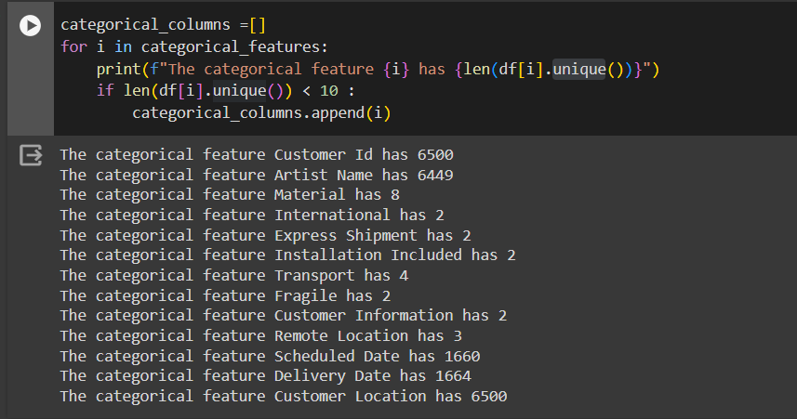
Unique values of categorical columns
The data set Has many categorical variables each expecting a unit count of levels.
We can see that customer ID and artist name feels display higher degree of uniqueness indicative of a broader customer base.
In contrast the material categories within 8 types only , Binary wearables such as international, Express shipment and installation included each consist of just two distinct values. The transport feature is slightly more varied with four types reflecting the different types of shipment fragile and customer information are also maintained in a binary nature.

Slide 14
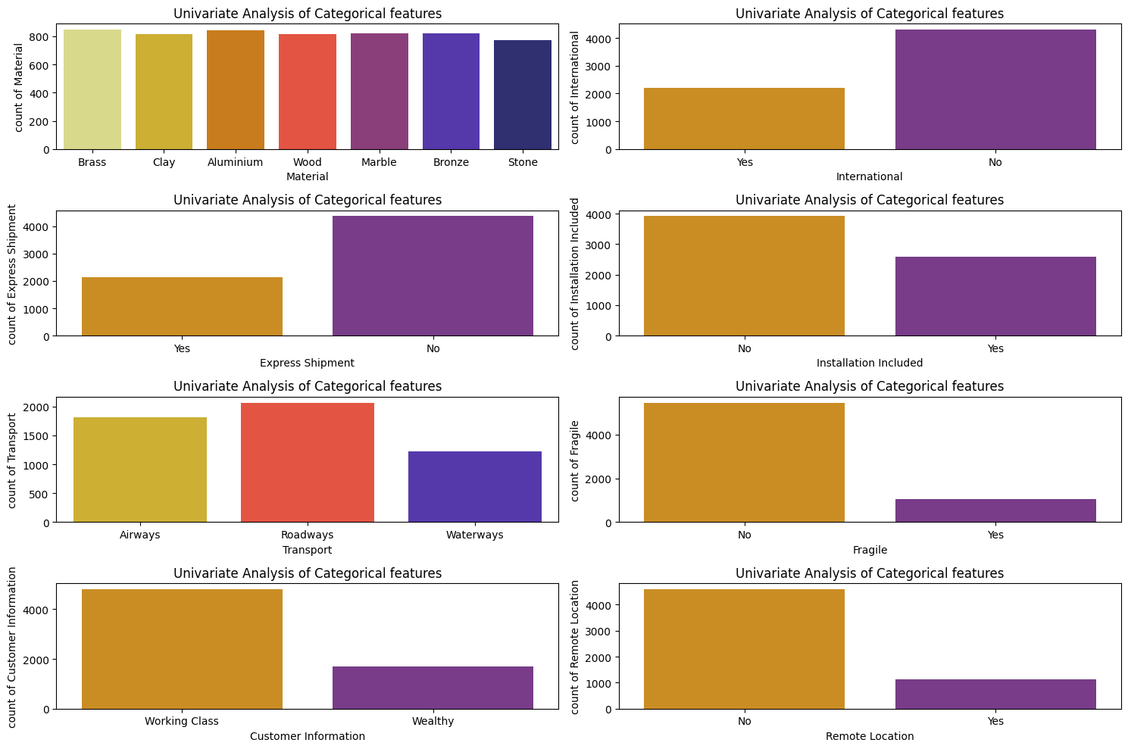
Distribution of categorical columns
In the graph we have displayed the bar graph for column which have unique values less than 10 ,
We can see that we have some columns which have Binary values like ‘Yes’ and ‘No’.
And other columns like materials such as brass aluminum and wood are most common while stolen marble are less frequent.

Slide 15
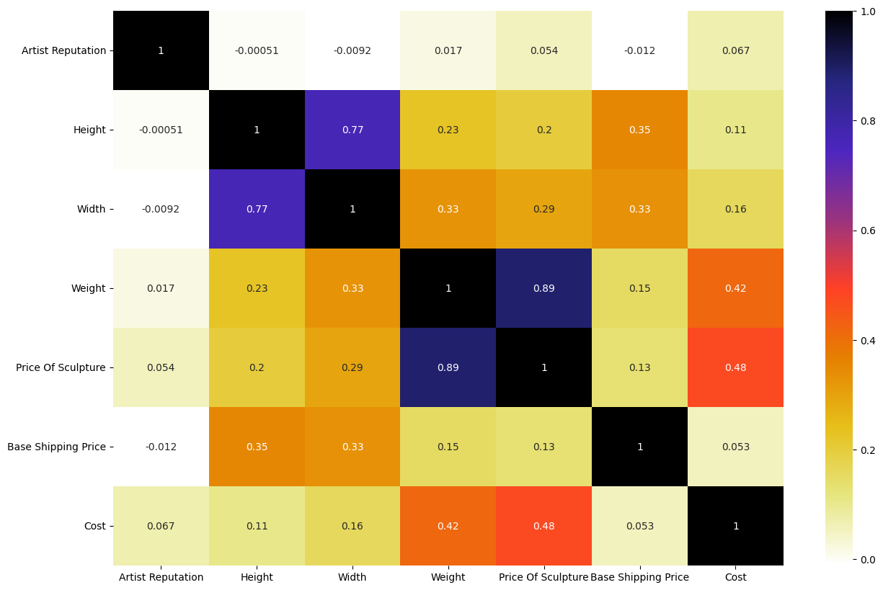
Correlation b/w numerical columns
The heat may provided has the correlation coefficient between various numerical features within Dataset.
The strongest correlation observed are Height and Width and weight , prices of sculpture which are relatively intuitive as larger and heavier sculptures would generally be more costly.
These features also show a moderate correlation with base shipment price.
Artist reputation seems to have little to no correlation with Aadhaar variables indicating that artists work does not strongly influence the physical or base cost of shipping.
Correlation between price of the sculpture and cost is moderate which could suggest that while sales price impacts total shipping cost it is naughty solo determinant.

Slide 16
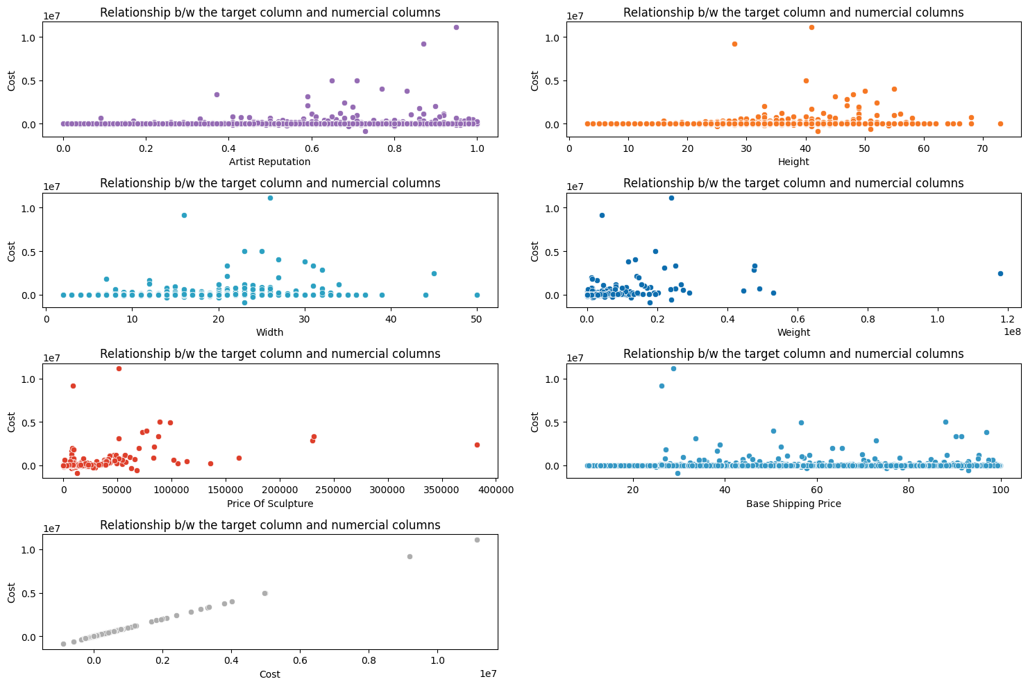
Relationship b/w the target column and numerical columns
In this graph we have plotted the relationship between the numerical columns and the target column.
For artist reputation doesn’t appear to be a clear trend indicating a strong relationship cost.
Both Width and height shower some degree of fast correlation with cost as larger the item seems to be higher the cost.
Weight presence more positive trend reflecting the logistic challenges and costs associated with shipping and heavy item.
Price of the culture and base shipping price board display passed correlation with car which are understandable since higher value sculptures may require more insurance etc.

Slide 17
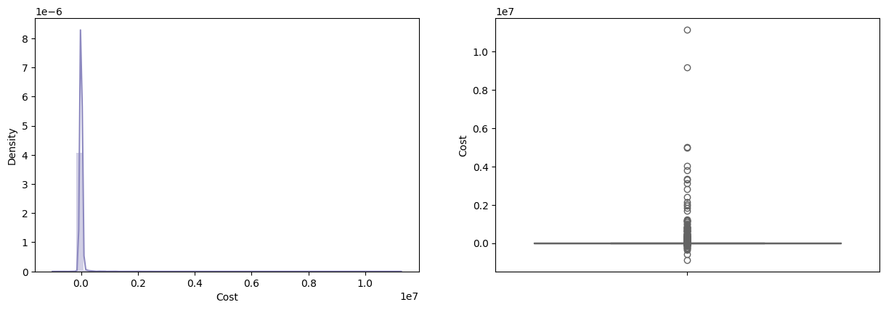
Distribution of the Target Variable
The visualizations provided for the target wear ruble which is the cost of shipping sculptures.
The Density plot on the left indicates that highly skewed distribution with Sharp P closely to Lorentz suggesting that majority of Supreme Court are low.
The box plot on the right shows that several point are extended far beyond the upper quartile which are likely to be extreme values or anomalies with data set.

Slide 18
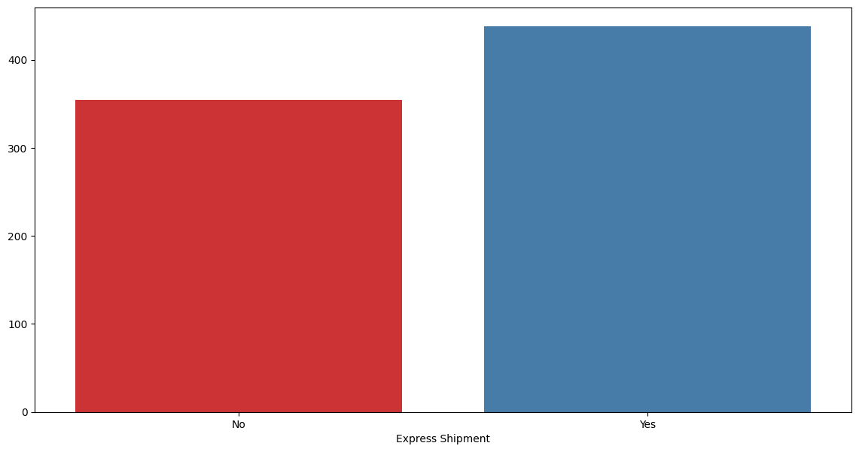
Express Shipment vs Median Cost
This bar chart illustrates the median shipping costs incurred when choosing express shipment versus standard shipment options.
The red bar represents the median cost without express shipment. The blue bar shows the median cost with express shipment. Express shipment appears to be associated with higher median costs.

Slide 19
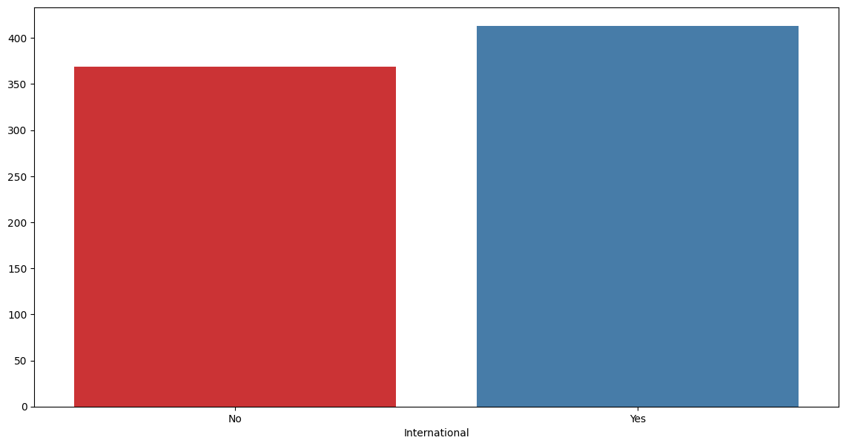
International shipping vs Median Cost
This bar chart illustrates the median shipping costs incurred when choosing international shipment versus standard shipment options.
The red bar represents the median cost without international shipment. The blue bar shows the median cost with international shipment. Internationla shipment appears to be associated with higher median costs.

Slide 20
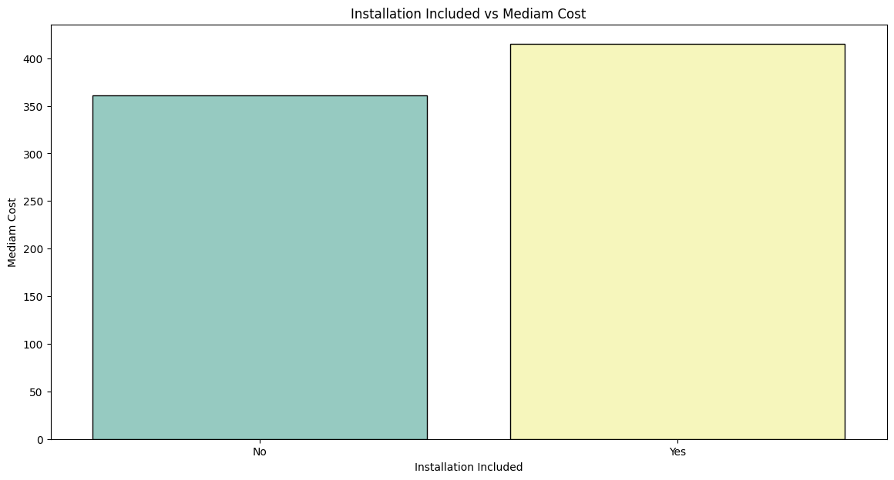
Installation Included vs median Cost
This car likely displays the medium cost for shipping with and without the conclusion about relation services. the median cost for shipment that includes installation is higher than those that don’t

Slide 21
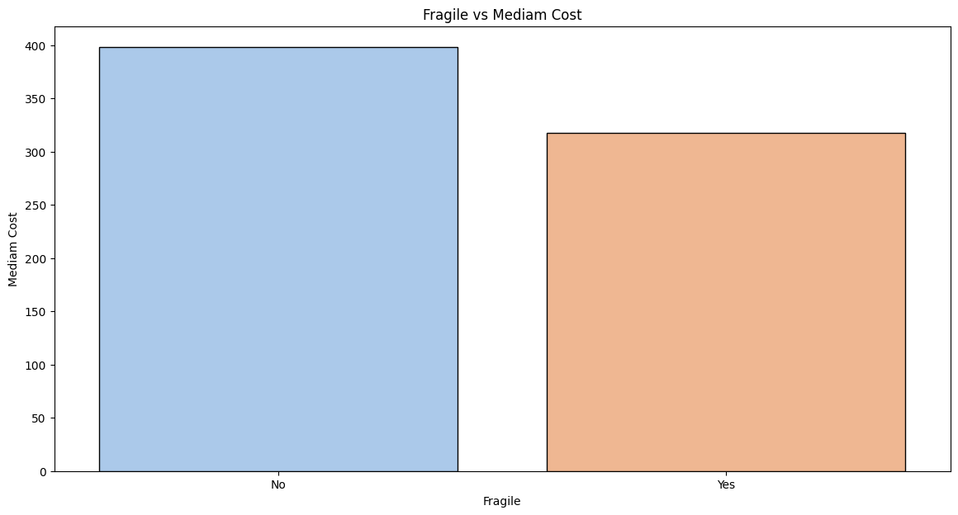
Fragile vs Median Cost
The graph compares the median cost of shipping the tarmac that are marked as fragile vs that are not typically fragile items required more carefully handling the packaging potentially increasing strength cost.

Slide 22
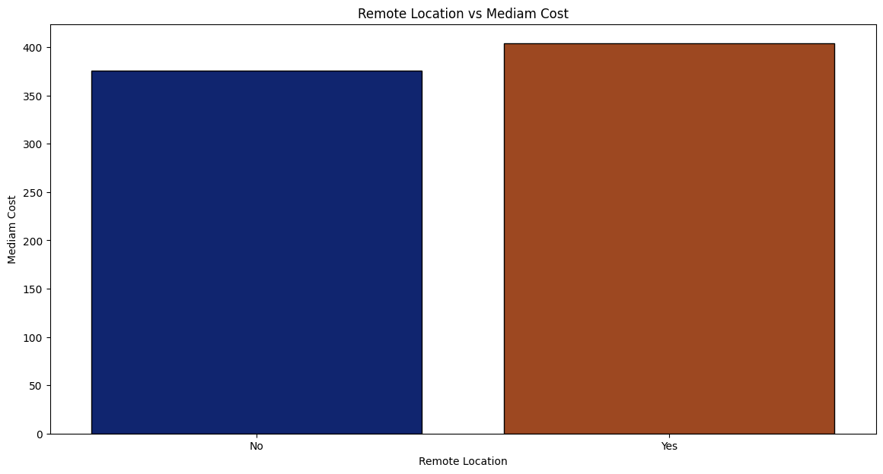
Remote Location vs Median Cost
Here the comparison would be between shipments to remote locations and those to more accessible areas shipping to remote locations generally a need additional Logistics and higher costs

Slide 23
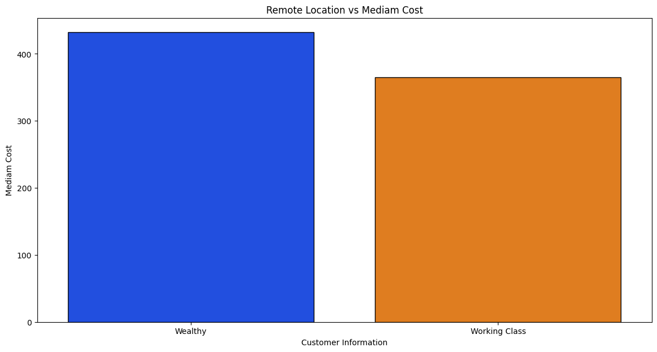
Customer Information vs Median Cost
Young socialization we are comparing the median shipping cost across different customer segment such as welding vs working class. It could reveal whether the cost difference based on customer class probably reflecting differences in the service limits or shipping preferences

Slide 24
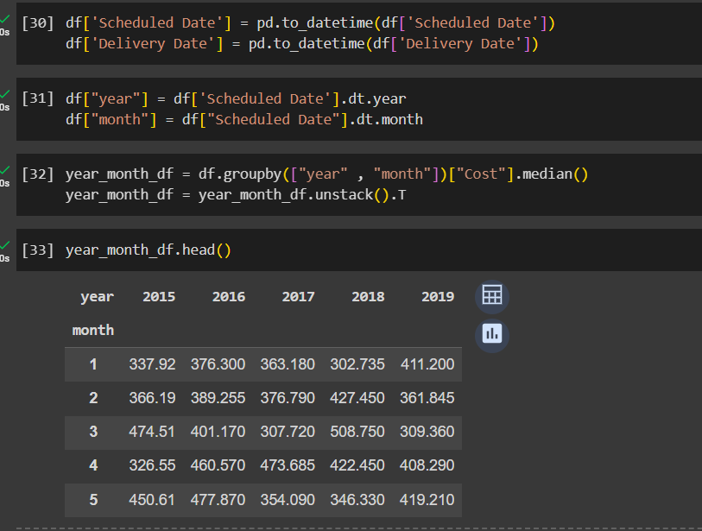
Temporal Analysis of Shipping Costs
The table gives the median checking cost across different months and years providing a clear view of cost variability over time.
Analyzing the median cost helps in avoiding the effect of outliers thereby offering a more robust understanding of typical cost.
Temporal breakdown helps discerning seasonal trends and identifying the periods of higher and lower shipping expenses.
This data will help in forecasting budgets aligning logic strategies with demand cycle and setting dynamic prices policy within the observed time.

Slide 25
Temporal Analysis of Shipping Costs
The table gives the median checking cost across different months and years providing a clear view of cost variability over time.
Analyzing the median cost helps in avoiding the effect of outliers thereby offering a more robust understanding of typical cost.
Temporal breakdown helps discerning seasonal trends and identifying the periods of higher and lower shipping expenses.
This data will help in forecasting budgets aligning logic strategies with demand cycle and setting dynamic prices policy within the observed time.

Slide 26
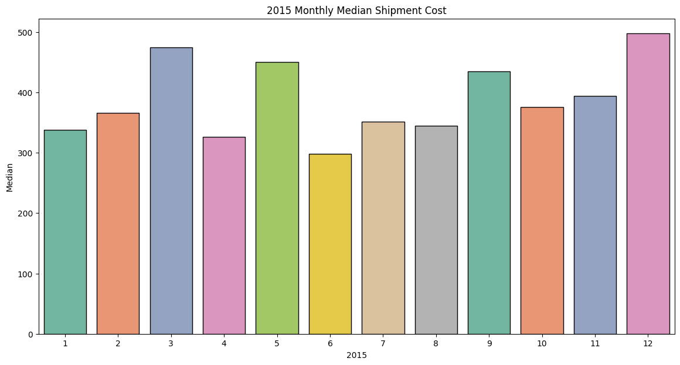
2015 Monthly Median Shipment Cost
Peaks and troughs In the monthly medium costs indicate seasonal variation potentially linked to change in the man or operational cost throughout the year.
The costs are high at beginning at the end of the year which strongly corresponds with increasing shipping activities during holidays and promotional periods.

Slide 27
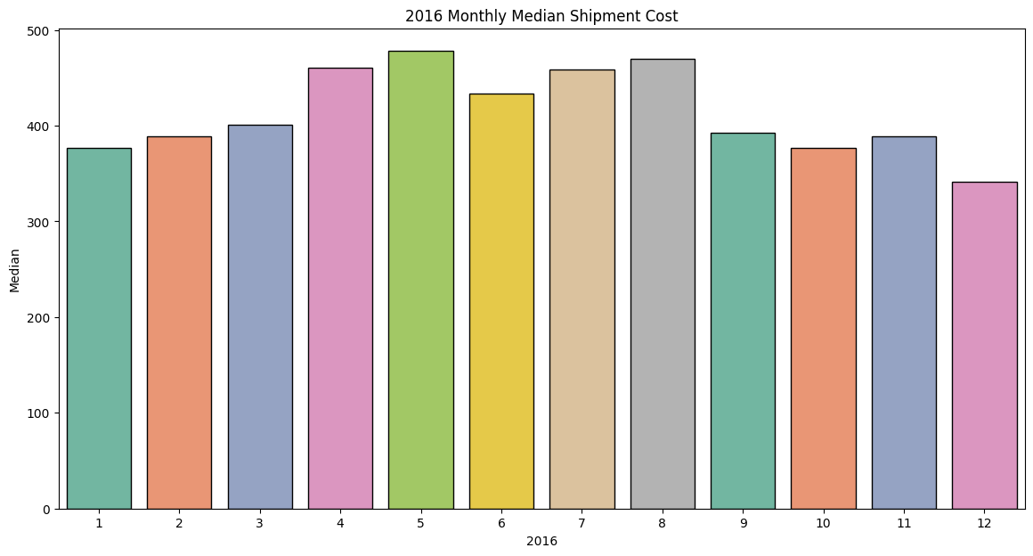
2016 Monthly Median Shipment Cost
A single pattern to 2015 is observed with higher shipping costs in early months suggesting a consistent trend across here the mid year months show relatively low median costs indicating a possible decrease in shipping activities are more efficient cost management during this.

Slide 28
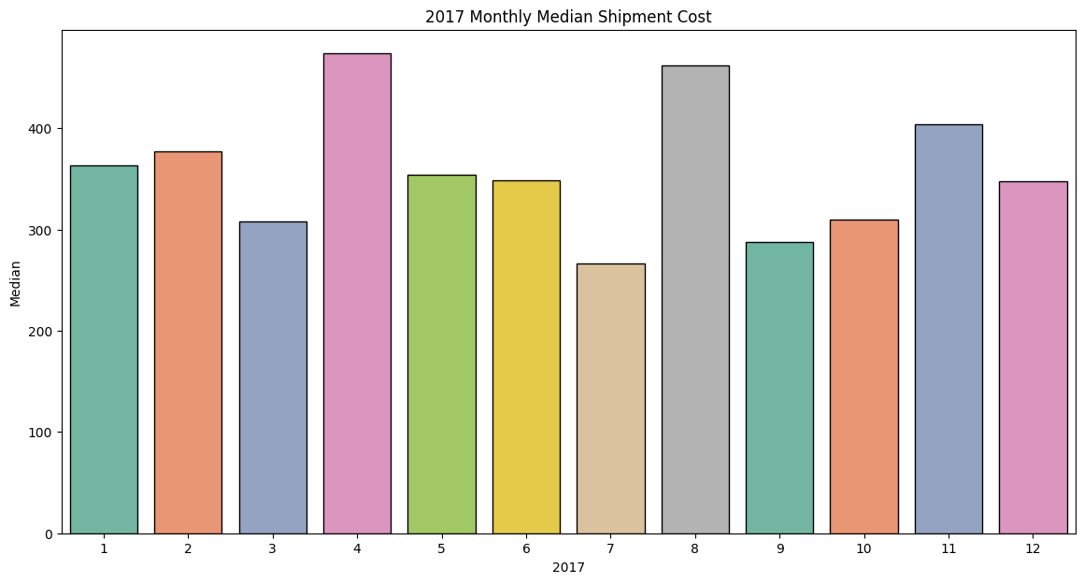
2017 Monthly Median Shipment Cost
The reason marked spike in median cost during the mid year which could be due to the specific events affecting the shipping cost such as increase in raw materials or fuel pipe the end of year rises in median cost remains consistent mirroring the trends seen in the previous years

Slide 29
2018 Monthly Median Shipment Cost
The distribution of costs across the month is more uniform compared to previous years with a slight increase in specific months that may reflect. Comment on checking operations. The costs towards the year end don’t show a significant increase as in the previous years.

Slide 30
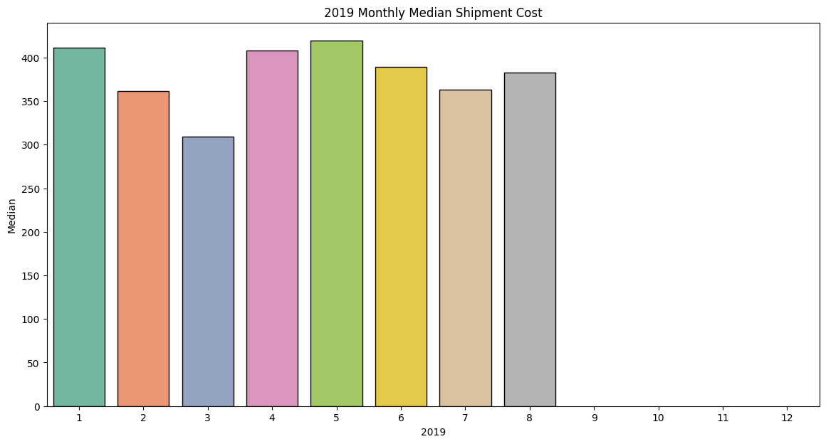
2019 Monthly Median Shipment Cost
A sharp increase in median cost at the starting of the year possibly indicating the changing market dynamics or a response to external economic factor. The year 2019 continues to show a variability in each month emphasizing the need for adaptive pricing strategies to accommodate these fluctuations.

Slide 31
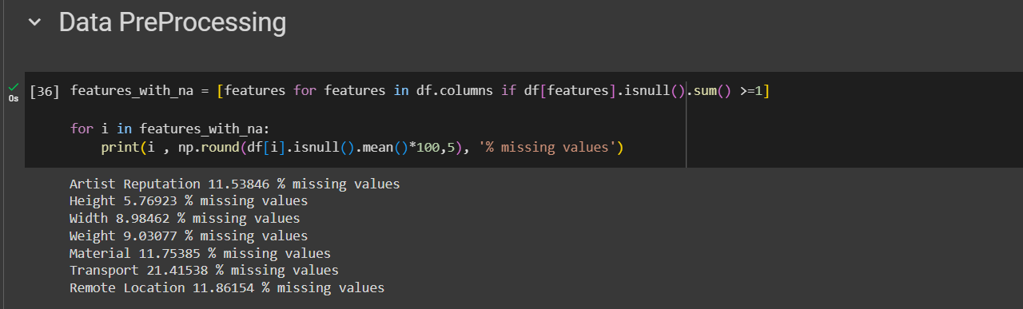
Null Values
we've identified key features with missing data. Artist reputation materials have approximately 11.5% missing values each would impact models performance.
The transport feature has the highest percentage of missing values at over 21%.
With under 12% missing allies remote location data will be required careful handling ensuring that any impetus that does not introduce bias.

Slide 32
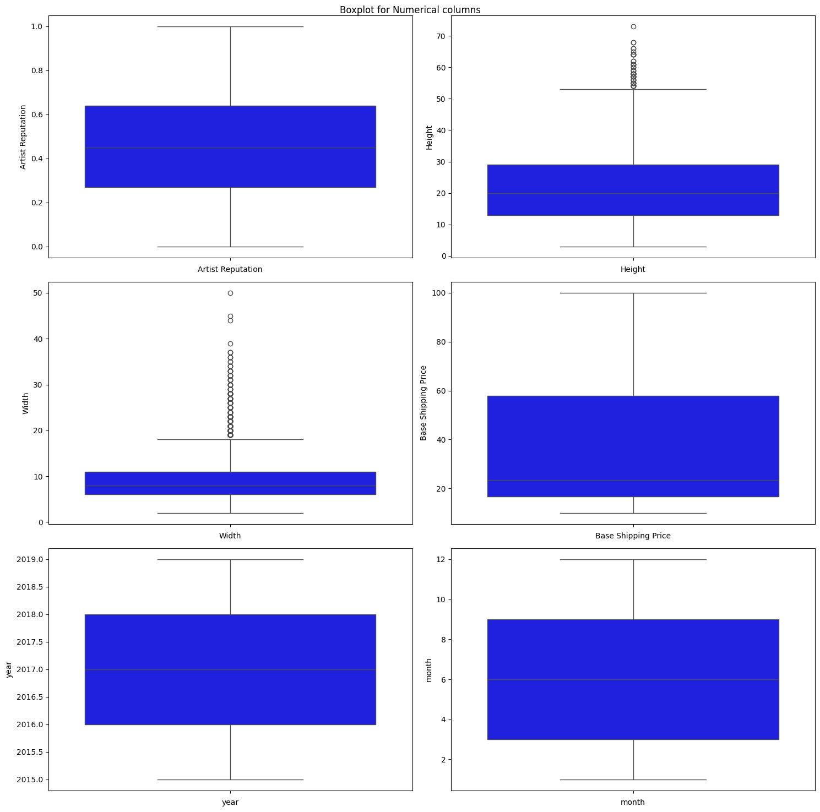
Outlier Detection and Distribution Analysis
The boxplots Passenger visual summary of distribution of the numerical features including artist reputation height width and base shipping price alongside temporal features like ear and month. Artist reputation is mostly centralized within a few outliers indicating a wide varied levels.
Height and width displace a right skew distribution with several outliers suggesting a range of sculpture sizes.
Best shipment price shows borrowed spread implying a diverse cost structure within shipping operations.
We have used this insight in the data cleaning and outliers treatment steps.

Slide 33
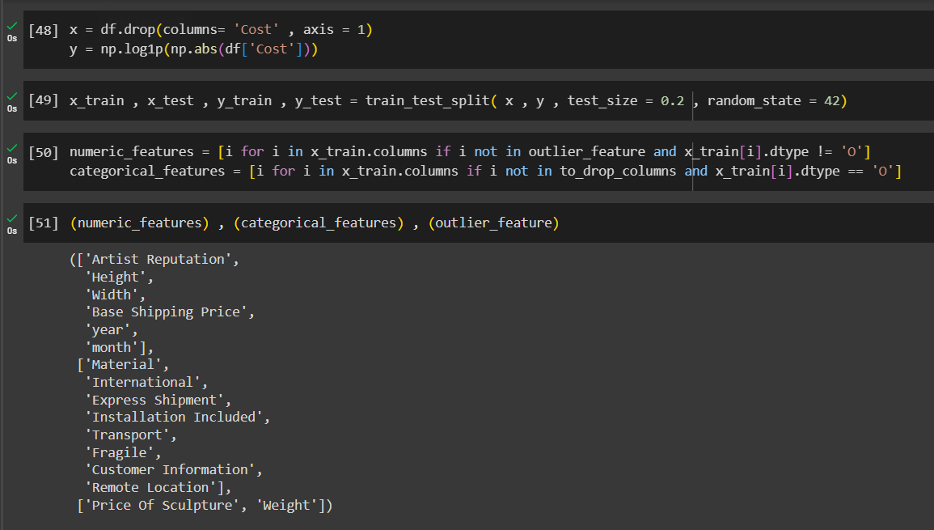
Splitting the Dataset into train and test
The data set has been reverted into features and target variables with cost being dropped from feature set as it’s the variable we are trying to predict.
The datacenter has been partitioned into train and testing insuring that model can be trained on subset of data and validated on the other. This helps in evaluating the model performance on unseen data and reduce the risk of overfitting.
Logarithmic transformation is Roost on the target variable as it helps to stabilize Liberians across the range of the data that can lead to aggregate skewed data and this also reduce the effect of outliers.
Many algorithms assume that target wearable is normally distributed applying a lock transformation can make the data more normal leading to better moral performance

Slide 34
Splitting the Dataset into train and test
The data set has been reverted into features and target variables with cost being dropped from feature set as it’s the variable we are trying to predict.
The datacenter has been partitioned into train and testing insuring that model can be trained on subset of data and validated on the other. This helps in evaluating the model performance on unseen data and reduce the risk of overfitting.
Logarithmic transformation is applied on the target variable as it helps to stabilize variance across the range of the data that can lead to resolve the skewness and this also reduce the effect of outliers.
Many algorithms assume that target wearable is normally distributed applying a lock transformation can make the data more normal leading to better moral performance

Slide 35
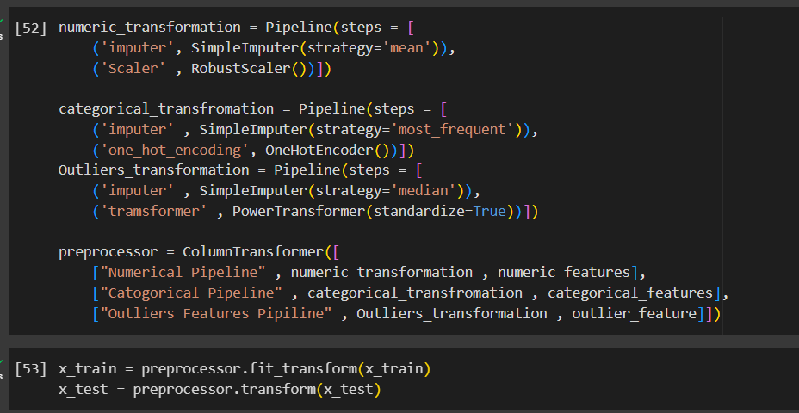
Preprocessing pipeline
Missing values in the numerical features are filled with the mean of each feature and RobustScaler is used on the numerical data , which reduce the effect of outliers.
The Missing values in categorical features are filled with the most frequent value and then one hot encoding is applied to convert categorical variables into a form that could be provided to machine learning algorithm.
For the filters which have many outliers the missing values in those features are filled with median and And then the power transformer is applied to make the distribution similar to Gaussian.

Slide 36
Preprocessing pipeline
Missing values in the numerical features are filled with the mean of each feature and RobustScaler is used on the numerical data , which reduce the effect of outliers.
The Missing values in categorical features are filled with the most frequent value and then one hot encoding is applied to convert categorical variables into a form that could be provided to machine learning algorithm.
For the filters which have many outliers the missing values in those features are filled with median and And then the power transformer is applied to make the distribution similar to Gaussian.

Slide 37
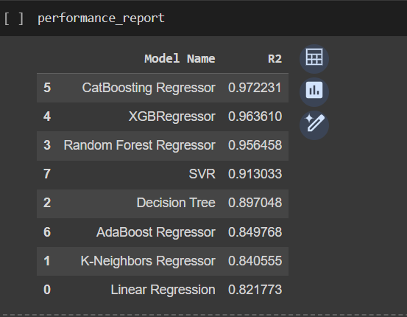
Model Evaluation Report
For predicting the shipment cost we have used different kind of machine learning models. The cat boasting regressor outperforms Other models with the highest R ^2 value of approximately 0.972 Indicating that it can explain around 97.2 percentage of variability in shipment cost data.
This is closely followed by exhibit and random forest with R ^2 value of oh .96 and 0 .95 respectively showcasing strong predictive capability. Traditional models like linear regression and K neighbors have lower R ^2 values suggesting that the data is better captured by more complex algorithms. This performance metrics evolution is critical for selecting the most effective model for deployment in real world shipping cost prediction system.
https://www.proquest.com/docview/1951119911?pq-origsite=gscholar&fromopenview=true

Slide 38
Resources and Related Projects
Real-Time Shipment Duration Prediction (https://www.proquest.com/docview/1951119911?pq origsite=gscholar&fromopenview=true.) : The study addresses the challenge of predicting shipment durational global manufacturing where components and finished goods are procured from Delivered to various international locations it focuses on improving forecast accuracy to reduce unexpected supply chain cost caused by three PL providers.
Shipment status prediction in online crowd-sourced shipping platforms(https://www.sciencedirect.com/science/article/pii/S2210670718326647) : The study examines burgeoning field of crowd-shipping , Leveraging public participation for package delivery via technology platforms. It offers insights into the operational and behavioral aspects of crowd shipping and its potential for more sustainable urban transport.
Establishment of Shipping Container Price Prediction Model for International Trade (https://ieeexplore.ieee.org/abstract/document/10063390) : This IEE document details research on forecasting containers freight rate in Chinese international trade. The study critiques Existing models for overlooking time series characteristics leading to low accuracy in predictions.

Slide 39
Repository
Link - https://github.com/tatavartysrinivas/CSCE-5310-Methods-in-Emperical-Analysis---Shipment-Price-Prediction.

